Slide 1

General Guide to the Rat
In the name of God
The Norway rat
(Rattus norvegicus)

Slide 2
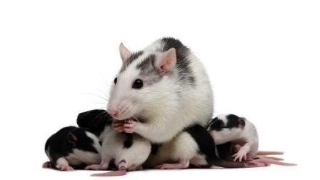
PART 1
Introduction

Slide 3
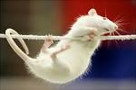
Taxonomy:
Kingdom: Animalia
Phylum: Chordata
Class: Mammalia
Order: Rodentia
Family: Muridae
Subfamily: Murinea
Genus: Rattus
Species: Norvegicus

Slide 4
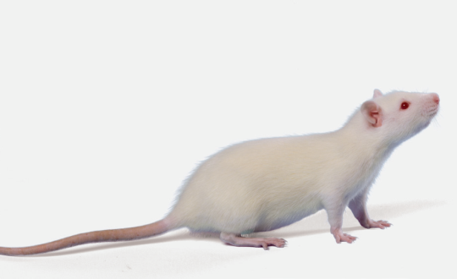
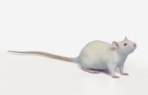

Origin : South –east Siberia
north- east China
Common strains:
Sprague-Dawley: albino
narrow head
tail longer than body
Wistar: wide head
shorter tail
Long-Evans: smaller
darker hair over portions of head and anterior body

Slide 5
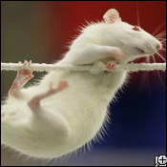
Biology
Os penis like other rodents
1/1 Incisors + 3/3 Molars
Gnawing apparatus: remarkable
contionously erupting
chisel like incisor
long diastema
loose cheek skin
Like other rodents (young)
Masses of brown fat cervical ocations+between scapulae
Albino rats: poor eyesight
Harderian gland (pigmental lacrimal gland)

Slide 6
Growing pattern
Newborn: 5 gr
Adult male: 450-520 g (prolonged period of growth- second year)
Adult female: 250-300 g (first several months of life)
Food consumption: 5-10 g/100g/day
Water consumption: 10-12 g/100g/day

Slide 7
Physiological Values
Adult body wieght: male | 450-520 g
Adult body wieght: female | 250-300 g
Birth wieght | 5-6 g
Body temperature | 35.9-37.5
Diploid number | 42
Life span | 2.5-3.5 y
Food consumption | 10g/100g/day
Water consumption | 10-12 ml/100g/day
Breeding onset: male | 65-110 days
Breeding onset: female | 65-110 days
Cycle lenght | 4-5 day
Gestation period | 21-23 days
Postpartume estrus | fertile
Litter size | 6-12
Weaning age | 12 days
Breeding duration | 350-440 days
Young production | 4-5 /mo

Slide 8
Physiological Values Contine…
Milk Compositon | 13% fat, 9.7% protein, 3.2% lactose
Respiratory rate | 70-115 / min
Tidal volume | 0.6-2 ml
Oxygen use | 0.68-1.10 ml/g/hr
Heart rate | 250-450 /min
Blood volume | 54-70 ml/kg
Blood pressure | 84-134/60 mm Hg
Erythrocyte | 7-10×103 / mm3
Hematocrit | 36-48%
Hemoglobin | 11-18 gm/dl
Leukocyte | 6-17×103/mm 3
neutrophils | 9-34%
lymphocytes | 65-85%
monocytes | 0-5%
basophils | 0-1.5%
eosinophils | 0-6%

Slide 9
Physiological Values Contine…
Platelets | 500-1300×103
Serum protein | 5.6-7.6 g/ml
Albumin | 3.8-4.8 g/dl
Globulin | 1.8-3 g/ml
Serum glucose | 50-135 mg/dl
Blood urea nitrogen | 15-21 mg/dl
Creatinine | 0.2-0.8 mg/dl
Total bilirubin | 0.20-0.55 mg/dl
Serum lipids | 70-415 mg/dl
Phospholipids | 36-130 mg/dl
Triglycerides | 26-145 mg/dl
Cholesterol | 40-130 mg/dl
Serum calcium | 5.5-12 mg/dl
Serum phosphate | 5.3-8.3 mg/dl

Slide 10
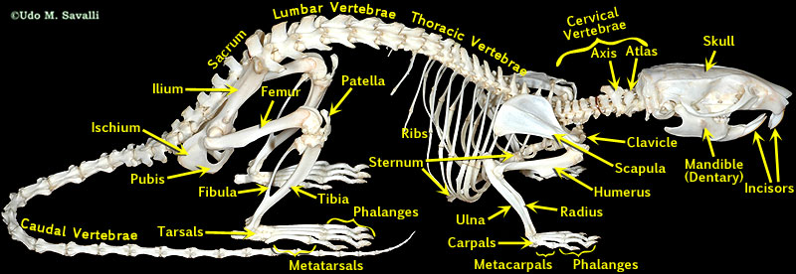

Slide 11


Sexing
1- Testicles : early age
2- larger genital papilla
3- greater anogenital distance (5 mm at 7 days)
1- fewer anogenital distance (2/5 mm at 7 days)
2- nipples (8-15 days)
* Double cervix, too long uterus horn
- Polyestus +minor seasonal variations
- Estrus cycle: 4-5 days
- Estrus period: 12 h (evening)
proestrus: epithelial cells + coronified cells + leukocyte
- vaginal smear estrus: coronified cells
metesterus+ diestrus: cornification + leukocytes

Slide 12
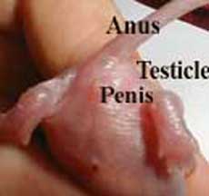
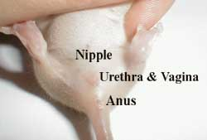
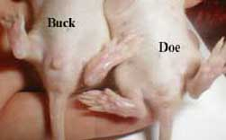

Slide 13

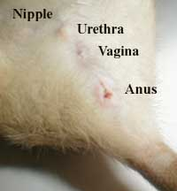
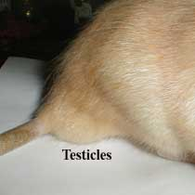
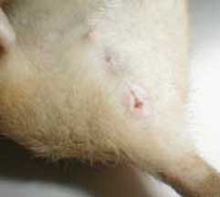

Slide 14
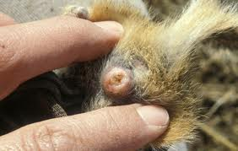
-Mating : waxy copulatory plug 12-24h postcoitum
palce dark and clean paper
-Gestation period: 21-23 d
-PostPartum estrus : 48 h fertile
delay in implantation
gestation period 4-5 days longer
-Detection pregnancy: palpation, observation, weighed,
mammary development (14d)
-Peusedopregnancy: not common

Slide 15
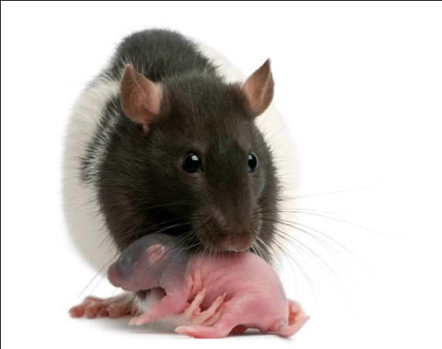
-Mathernal behavior: darn licks her perineum
nesting
clear vaginal mucus
-Mean litter numbers: 6-12
-Eye + hair: 7 d
-Weaning age: 21 d (40-50d)

Slide 16
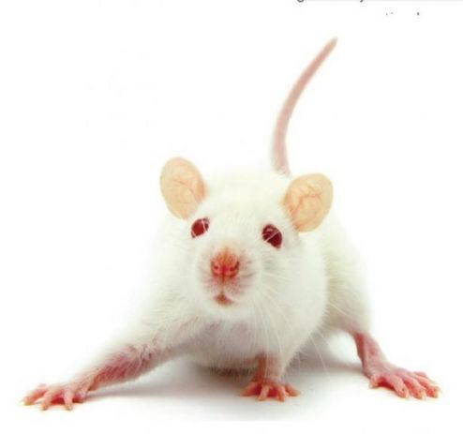
PART 2
Outbred strains of Rats

Slide 17
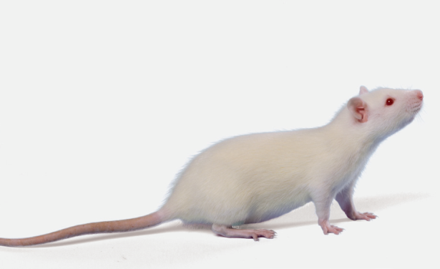
Sprague Dawley® Rat Crl:SD
Origin:
R.W Dawley in 1926, from a hooded male hybrid and an albino female (probably Wistar) and was crossed with the femal’s progeny for 7 generations.
To SASCO from ARS/Sprague Dawley in 1979. To Charles River in 1996.
Coat Color :White (albino), elongated head + tail longer than body
Ideal For: general multipurpose model, safety and efficacy testing, aging, nutrition, teratolology, toxicology, oncology

Slide 18
Wistar Han IGS Rat Crl:WI(Han)
Origin
This strain was selected by DOLANSON in 1906 at the Wistar rat
Rederived by GlaxoWellcome from Han Wistar stock supplied by BRL. Transferred to Charles River UK in 1996.
The Wistar rat is used in all fields of medical and biological research. Its longenvity and high rate of spontaneouse tumors make it an ideal choice for ageing studies
Coat Color: White (albino)
Ideal For:general multipurpose model, safety and efficacy testing, aging, oncology, teratology, oncology, physiology

Slide 19

Long-Evans Rat Crl:LE
Origin
Developed by Dr Long and Dr Evans in 1915. The Long Evans rat is the result of a cross between a female albino from the Wistar institute and a wild male (Rattus borvegicus) captured near Berkeley and offspring selection
Originated by Drs. Long and Evans in 1915 by crossing several Wistar Institute white females with a wild gray male. To Charles River from Canadian Breeding Farm and Laboratories in 1978.

Slide 20

Long-Evans Rat Crl:LE
Coat Color : White with black hood; occasionally white with brown hood
Ideal For: general multipurpose model, behavioral research, Agening, merabolism , toxicology,stress, locomotion

Slide 21
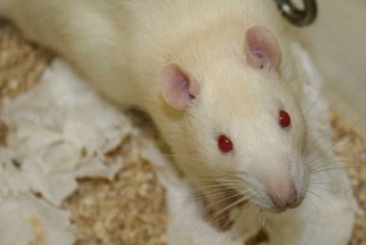
CD® Hairless Rat Crl:CD-Prss8^{hr}
Origin: This spontaneous mutation model was isolated from a Crl:CD(SD) colony in Charles River, in the late 1980s. Rederived in 1993 and subsequently transferred to Charles River, Raleigh, NC for barrier room production. The model does not exhibit the typical characteristics of hair growth and loss found in other hairless models. Specific genetic analysis to identify the mutation has not been undertaken. Histopathology has determined the model is euthymic.
Coat Color : Hairless, albino background
Ideal For: Wound healing model, dermatology, safety and efficacy testing

Slide 22
CD® IGS Rat Crl:CD(SD)
Origin : Originated in 1925 by Robert W. Dawley from a hybrid hooded male and a female Wistar rat. To Charles River in 1950 from Sprague Dawley, Inc. In 1991, 8 colonies were selected to form the IGS Foundation Colony. Rederived into an isolator foundation colony in 1997. IGS refers to animals bred using the Charles River
Coat Color : White (albino)
Ideal For: General multipurpose model, safety and efficacy testing, aging, nutrition, diet induced obesity, oncology,

Slide 23
Lister Hooded Rat Crl:LIS
Origin
These rats have taken their name from the Lister Institute, where the stock first originated. From Glaxo to Charles River Laboratories UK in 1990 and again in 1996. To Charles River Germany in 2007.
Coat Color : Predominantly white with a black hood
Ideal For: Noted for its docility and good breeding performance. Susceptible to audiogenic seizures.

Slide 24
Obese Prone CD Rat Crl:OP(CD)
Origin
Developed from a line of Crl:CD(SD) rats. Two lines were developed from this outbred colony, the OP-CD (Obese Prone) and OR-CD (Obese Resistant). This model becomes obese when fed high-fat diets. Obesity develops despite having a fully functioning leptin receptor. The control for this model is the Crl:OR(CD).
Coat Color: White (albino)
Ideal For: obesity, metabolic syndrome NOTE: This model can be preconditioned on a diet.

Slide 25
Obese Prone CD Rat Crl:OP(CD)
Origin
Developed from a line of Crl:CD(SD) rats. Two lines were developed from this outbred colony, the OP-CD (Obese Prone) and OR-CD (Obese Resistant). This model becomes obese when fed high-fat diets. Obesity develops despite having a fully functioning leptin receptor. The control for this model is the Crl:OR(CD).
Coat Color White (albino)
Ideal For: obesity, metabolic syndrome NOTE: This model can be preconditioned on a diet.

Slide 26
Obese Resistant CD Rat Crl:OR(CD)
Origin
Developed from a line of Crl:CD(SD) rats. Two lines were developed from this outbred colony, the OP-CD (Obese Prone) and OR-CD (Obese Resistant). This model does not become obese when fed high-fat diets.
Coat Color White (albino)
Ideal For: control model for Obese prone CD rat

Slide 27
OFA Rat Crl:OFA(SD)
Origin
The original strain was composed in 1925 by Robert Worthington Dawley. Carworth Farms obtained it in 1955 and renamed it CFE (Carworth Farms Elias). Transferred to Charles River Laboratories France in 1967, it then became known as OFA (Oncins France Strain A), in 1968.
Coat Color :White (albino)
Ideal For: Pharmacology, toxicology, teratology, oncology, medicine control, physiology, experimental microbiology, experimental surgery, ethology

Slide 28
RNU Rat Crl:NIH-Foxn1^{rnu}
Origin
The NIH nude rat was developed in 1979–1980 through a series of matings involving 8 inbred rat strains. To Charles River from the National Institutes of Health in 2001. This athymic nude rat is T-cell deficient and shows depleted cell populations in thymus-dependent areas of peripheral lymphoid organs.
Coat Color: White, black, black and white
Ideal For:Tumor biology, immunology, and xenograft research

Slide 29
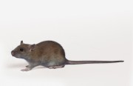
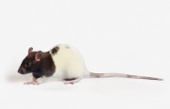
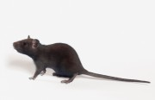
PART 3
Inbred strains of Rats

Slide 30
Bcrp TGEM® Knockout Rat Crl:WI(UL)-Abcg2^{m1Hubr}
Origin
At the Hubrecht Institute a nonsense mutation at amino acid position 59 (Glu to stop) within the catalytic center ABC transporter-like domain of the rat Abcg2 (Bcrp) gene was isolated which eliminates all wild-type protein. Transferred to Charles River under exclusive license from Transposagen in 2010.
Coat Color: White (albino)
Ideal For: ADME, drug transport, toxicology, pharmacokinetics, bioavailability, blood-brain barrier transport, stem cells, progenitor cells, proliferation, differentiation, tumor initiating cells, phototoxicity, protoporphyria, hypoxia

Slide 31
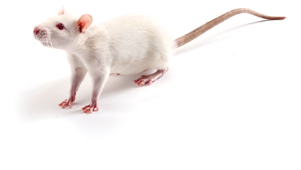
BDIX Rat BDIX/CrCrl
Origin: Druckrey from a cross between BDI and BDVIII with subsequent selection of brother-sister pairs for agouti coat color and dark, pigmented eyes. To Charles River in 1998 from the National Cancer Institute Animal Production Program (Cr).
Coat Color: Agouti
MHC Haplotype: RT1^{dv1}
Ideal For:Leukemia model, induction of malignant tumors

Slide 32
Brown Norway Rat BN/Crl
Origin: Silvers and Billingham began brother x sister matings with selection for histocompatibility in 1958 from a brown mutation in a stock of wild rats maintained by King and Aptekman in a pen-bred colony of rats trapped from the wild in 1930 by King at the Wistar Institute. To Charles River from Radiobiology Institute, Netherlands in 1976.
Coat Color: Non-agouti brown
MHC Haplotype; RT1^{n}
Ideal For:Genetic mapping, respiratory inflammation, immunological dysfunction, aging, transplantation research

Slide 33
Buffalo Rat BUF/CrCrl
Origin:Heston in 1946 from Buffalo stock of H. Morris. To NIH in 1951 at F10. To Charles River in 1998 from the National Cancer Institute Animal Production Program (Cr)
Coat Color:White (albino)
MHC Haplotype:RT1^{b}
Ideal For:Carcinogenesis, oncology

Slide 34
Copenhagen Rat COP/CrCrl
Origin:Curtis in 1921 at Columbia University Institute for Cancer Research. To National Cancer Institute (NCI) Animal Production Program (Cr). To Charles River from the NCI in 1998.
Coat Color:White with a brown hood
MHC Haplotype:RT1^{av1}
Ideal For:carcinogenesis research, prostatic adenocarcinoma model, oncology

Slide 35
Dahl/Salt Sensitive Rat SS/JrHsdMcwiCrl
Origin : Inbred from a congenic control group of Dahl/SS rats (SS/JrHsd) obtained from Dr. Theodore Kurtz (UCSF, CA) which were originally derived from the Harlan SS/Jr colony. Maintained at the Medical College of Wisconsin since 1991, this strain has undergone considerable marker-selected breeding to eliminate residual heterozygosity and genetic contamination. To confirm homozygosity, the strain was tested with 200 microsatellite markers (genome-wide scan at 20cM) all of which were homozygous for all regions tested. (Cowley et al. 2000, Physiol. Genomics 2:107-115). To Charles River in 2001.
Coat Color: White (albino)
Ideal For: hypertension, diastolic heart failure, nephropathy NOTE: This model can be preconditioned on a diet.

Slide 36
Dark Agouti Rat DA/Sca
Origin:Inbred from heterogeneous stocks with unknown antecedents, may be related to COP. Wistar Institute to Sir William Dunn School of Pathology Oxford in 1963 to Hannover in 1972 to Radcliffe Infirmary Oxford in 1974. SCANBUR obtained this strain from Radcliff Infirmary Oxford in 1977 at F25+.
Coat Color:Agouti
Ideal For:Experimental allergic encephalomyelitis, induced rheumatoid arthritis, oncology, cardiovascular, transplantation

Slide 37
F344 (SAS FISCH) Rat F344/NCrl
Origin
Derived from NIH stock in 1992 by SASCO. To Charles River in 1996.
Coat Color;White (albino)
MHC Haplotype:RT1^{lv}
Ideal For:general multipurpose model, aging, safety and efficacy testing, surgical model, oncology, nutrition

Slide 38
FHH Rat FHH/EurMcwiCrl
Origin
An outbred stock of fawn hooded rats was introduced into Europe by Tschopp in the early 1970s.
Maintained as an outbred stock until the mid-1980s, when brother x sister mating was initiated by A.P. Provoost to produce two strains designated FHH (also known as FHR) and FHL, which differ in expression of hypertension and proteinuria. The colony was transferred to Erasmus University in Rotterdam, The Netherlands, then to the Medical College of Wisconsin in the 1990s. To Charles River in 2001.
Coat Color: White with fawn hood
Ideal For:hypertension, nephropathy, pulmonary hypertension, alcohol consumption

Slide 39
Fischer (CDF®) Rat F344/DuCrl
Origin
From mating #344 of rats purchased from a local breeder (Fischer). Colony originated by M.R. Curtis, Columbia University Institute for Cancer Research in 1920. Dunning at Columbia inbred to form the strain starting in 1920. To Charles River in 1960 at F68.
Coat Color;White (albino)
MHC Haplotype:RT1^{lv}
Ideal For:general multipurpose model, aging, safety and efficacy testing, surgical model, oncology, nutrition
Strain Code:002

Slide 40
Fischer 344 Rat F344/IcoCrl
Origin
From mating #344 of rats purchased from a local breeder (Fischer). The colony was originated by M. R. Curtis, Columbia University in 1920. To the Germ-Free Animal Laboratory at CNRS, Gif-sur-Yvette, France from the Lobund Institute, University of Notre-Dame, South Bend, Indiana, U.S.A. Subsequently introduced to Charles River France in 1970 as an axenic colony.
Coat Color: White (albino)
Ideal For:General multipurpose model, aging, safety and efficacy testing, surgical model, oncology, nutrition

Slide 41
Goto-Kakizaki (GK) Rat GK/TohiCskCrljCrl
Origin
The Goto-Kakizaki (GK) rat is a non-obese Wistar substrain which develops Type 2 diabetes mellitus early in life. The model was developed by Goto and Kakizaki at Tohoku University, Sendai, Japan in 1975. To Chugai Pharmaceutical Co. To Charles River Japan in 1995. To Charles River Laboratories in 2006.
Coat Color: White (albino)
Ideal For:non-obese Type 2 diabetes, mild hyperglycemia, insulin resistant, hyperinsulinemia

Slide 42
Lewis Rat LEW/Crl
Origin
Developed by Dr. Lewis from Wistar stock in the early 1950s. To Charles River from Tulane in 1970 at F34.
Coat Color:White (albino)
MHC Haplotype:RT1^{I}
Ideal For:transplantation research, induced arthritis/inflammation, experimental allergic encephalitis, STZ-induced diabetes

Slide 43
Noble Rat NBL/CrCrl
Origin
Bogden in the mid-1970s from Noble strain rats (brother x sister mated but not descended from a single pair, and therefore not necessarily isogenic). To National Cancer Institute Animal Production Program (Cr) in 1978. To Charles River in 1998.
Coat Color:Black face with a black stripe down the length of a white body
MHC Haplotype:RT1^{I}
Ideal For: prostate carcinoma, oncology

Slide 44
PCK Rat PCK/CrljCrl-Pkhd1^{pck}/Crl
Origin
This model of polycystic kidney disease showing both kidney and liver involvement was identified in a colony of CD rats from the Charles River Japan production facility. The identification of the Pkhd1 gene mutation was reported by Katsuyama and associates in 2000. This autosomal recessive Pkhd1 gene mutation is a model of human autosomal-recessive polycystic kidney disease (ARPKD). To Charles River Laboratories in 2006.
Coat Color:White (albino)
Ideal For:polycystic kidney disease, autosomal recessive trait

Slide 45
SHR Rat SHR/NCrl
Origin
Okamoto, Kyoto School of Medicine, 1963, from outbred Wistar Kyoto male with marked elevation of blood pressure mated to female with slightly elevated blood pressure. Brother x sister mating with continued selection for spontaneous hypertension was then started. To NIH in 1966 from Okamoto at F13. To Charles River from NIH in 1973 at F32..
Coat Color:White (albino)
MHC Haplotype:RT1^{k}
Ideal For:genetic hypertension, hypertensive drug research, ADHD model, safety and efficacy testing

Slide 46
SHHF Rat SHHF/MccGmiCrl-Lepr^{cp}/Crl
Origin
Breeding stock for this colony was transferred to Dr. Sylvia McCune at the University of Chicago Medical School in 1983 from the laboratory of J.E. Miller at G.D. Searle and Company. The animals were developed by backcrossing the SHROB rat to the SHR/N rat. Dr. McCune obtained the colony after the seventh backcross and continued to inbreed past 20 generations to fix the congestive heart failure trait. To Genetic Models, Inc. in 1994. To Charles River in 2001.
Coat Color: White (albino)
Ideal For: heart failure, hypertension, type 2 diabetes, nephropathy, insulin resistance

Slide 47
SHROB Rat SHROB/KolGmiCrl-Lepr^{cp}/Crl
Origin
This mutation occurred in the laboratory of Dr. Simon Koletsky in 1969 at Case Western Reserve University School of Medicine. It was developed from a cross between a hypertensive female rat and a normotensive male Sprague Dawley rat. The colony was maintained as brother x sister matings in a closed colony at Case Western Reserve University School of Medicine since 1971. To Genetic Models, Inc. in 2000. To Charles River in 2001..
Coat Color; White (albino)
Ideal For :hypertension, hyperinsulinemia, obesity, nephropathy, metabolic syndrome, hyperlipidemia

Slide 48
SHRSP Rat SHRSP/A3NCrl
Origin
The Spontaneously Hypertensive Stroke Prone Rat (SHRSP)was isolated from Wistar-Kyoto rats by Okamoto and Aoki in 1963. The A3 subline was transferred to the National Institutes of Health in 1975 from Yamori at generation F36. To Charles River in 2002.
Coat Color:White (albino)
Ideal For:stroke, ADHD model, nephropathy, hypertension, osteoporosis

Slide 49
WAG Rat WAG/RijCrl
Origin
A.L. Bacharach, Glaxo Labs., U.K., 1924, from a Wistar stock. To Harrington in 1964 at F83. To MBL-TNO in 1953, after that to REP Institutes TNO, Rijswijk. To Charles River Germany from REP Institutes TNO in 1993.
Coat Color;White (albino)
Ideal For:general multipurpose model, epilepsy, behavior, immunology

Slide 50
Wistar Kyoto (WKY) Rat WKY/NCrl
Origin
Outbred Wistar stock from Kyoto School of Medicine to NIH 1971. This is the same stock from which the SHR/N strain was developed. To Charles River in 1974 from NIH at F11.
Coat Color:White (albino)
MHC Haplotype:RT1^{I}
Ideal For:control for the SHR rat, ADHD model

Slide 51
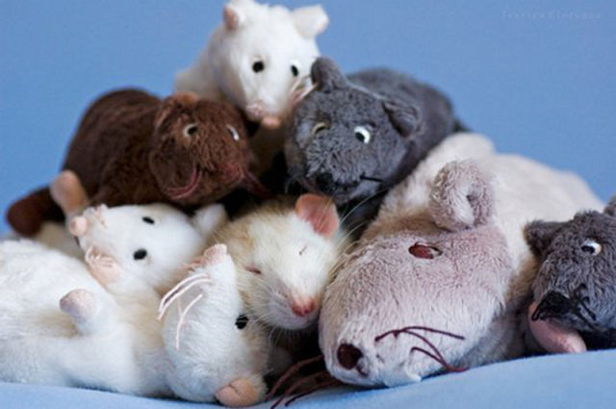
Thanks

